Slide 1
Youtube Songs Analysis
Presented by: Logeshwari r

Slide 2
Dataset Description:
1. video_id: Unique identifier for each YouTube video.
2. channelTitle: Title of the YouTube channel publishing the song.
3. title: Title of the YouTube song video.
4. description: Description provided for the YouTube song video.
5. tags: Tags associated with the YouTube song video.
6. publishedAt: Date and time when the YouTube song video was published.
7. viewCount: Number of views received by the YouTube song video.
8. likeCount: Number of likes received by the YouTube song video.
9. favoriteCount: Number of times the YouTube song video has been marked as a favorite.
10. commentCount: Number of comments posted on the YouTube song video.
11. duration: Duration of the YouTube song video.
12. definition: Video definition or quality (e.g., HD, SD).
13. caption: Availability of captions for the YouTube song video.

Slide 3
Project Objectives:
1. Data Cleaning and Preparation:
- Clean and preprocess the dataset, handling missing values or outliers.
- Convert relevant columns to appropriate data types.
2. Exploratory Data Analysis (EDA):
- Explore patterns and distributions in view counts, like counts, and comments.
- Identify trends in the popularity and engagement of YouTube song videos.
3. Content and Channel Analysis:
- Analyze the distribution of videos across different channels.
- Identify popular tags and their correlation with view counts.
4. Temporal Trends:
- Explore how YouTube song video metrics vary over time.
- Identify peak publishing times and their impact on engagement.
5. User Engagement Insights:
- Investigate relationships between likes, comments, and views.
- Identify factors influencing user engagement with YouTube song videos.

Slide 4
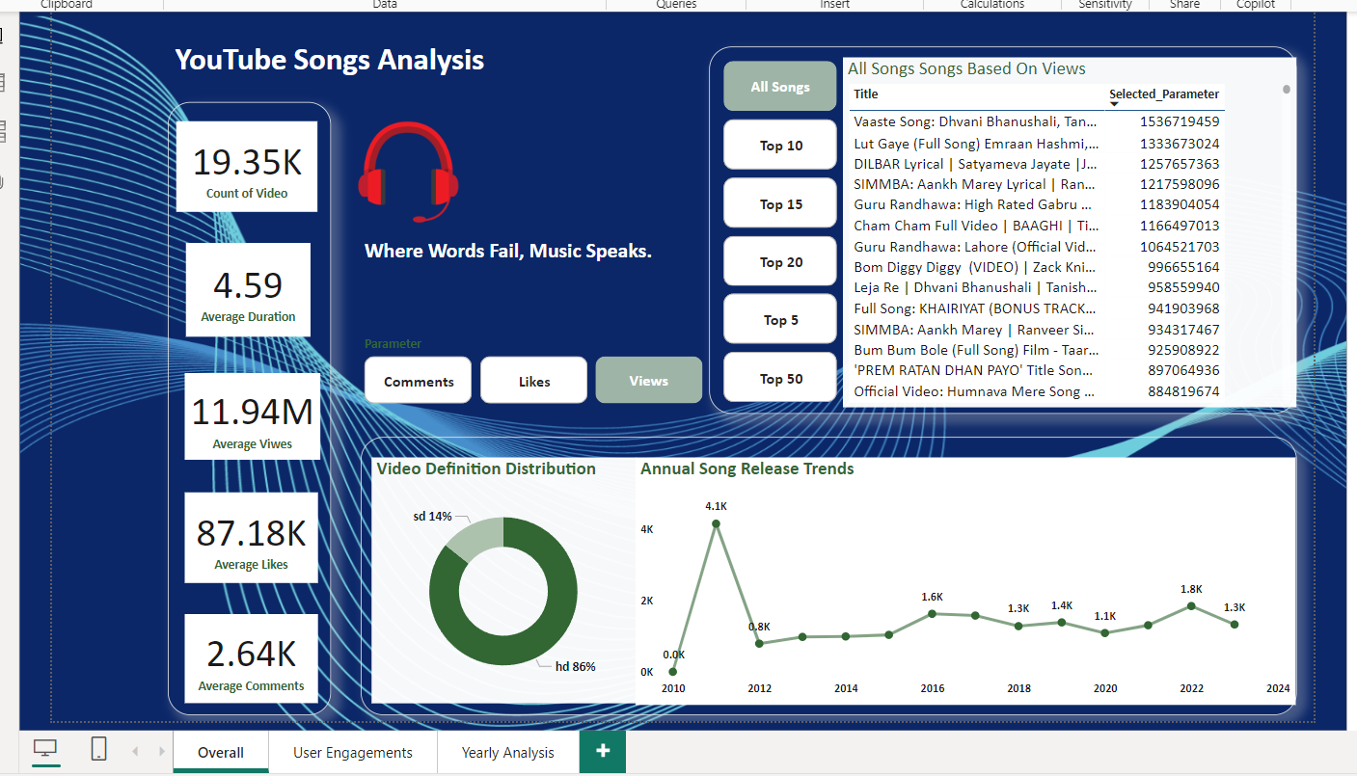
Content and channel analysis

Slide 5
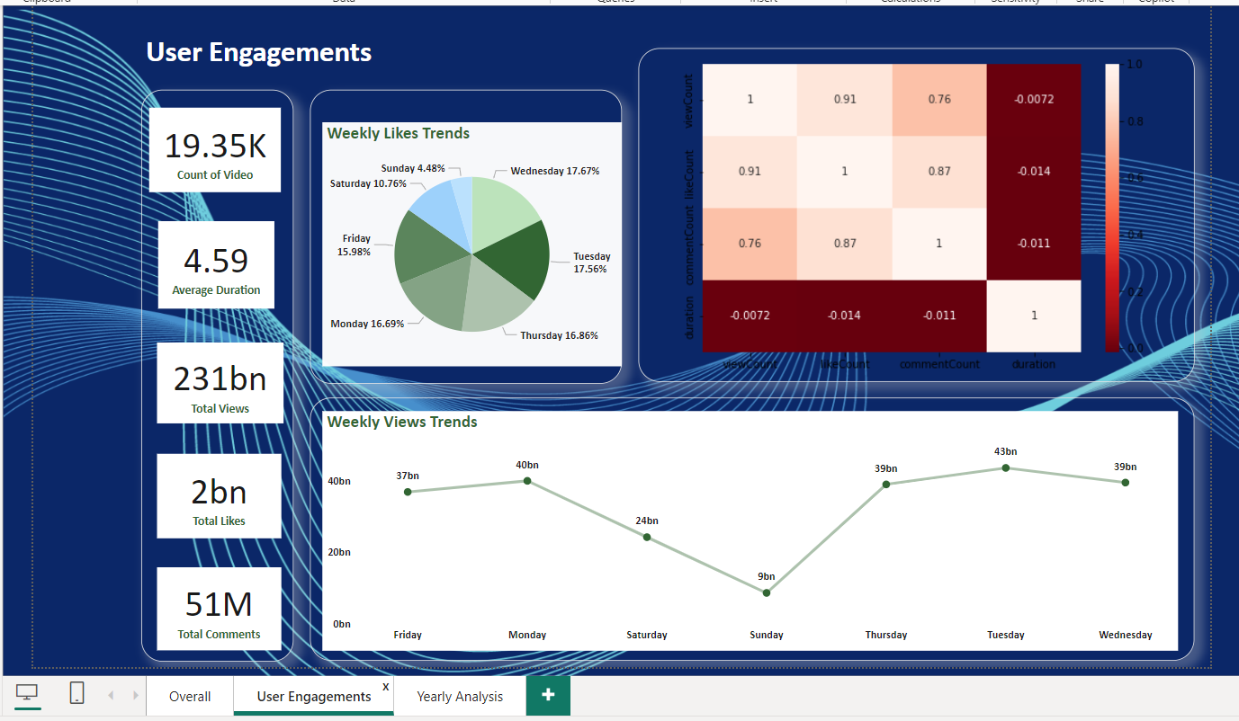
Temporal trends anaysis

Slide 6
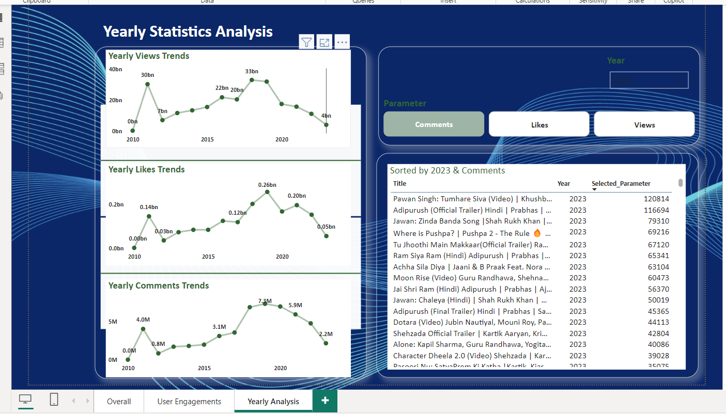
User Engagement insights

Slide 7
conlusion
1. Total and Unique Song Data:
- The dataset includes 19,345 unique songs, all from the T-Series channel.
- The data spans from 2010 to 2023, with notable variations in song releases and engagement over these years.
2. Temporal Analysis:
- Peak years for song releases include 2011, 2022, and 2016.
- Monthly analysis shows that May has the highest number of song releases, followed by April and July.
- Daily analysis indicates that Monday and Tuesday are the most active days for publishing songs, while Sunday sees the least activity.
3. Engagement Metrics:
- Statistical overview shows high variability in view counts, like counts, and comment counts.
- Maximum view count reaches over 1.5 billion, with an average of approximately 11.9 million views per song.
- Likes and comments also exhibit significant variability, with maximums of 12.8 million likes and420,375 comments.

Slide 8
4. Content Quality and Accessibility:
The majority of videos are in high definition (HD), accounting for 16,583 videos, while2,762arein standard definition (SD).
- Most videos do not have captions, with only 201 videos including captions.
5. Correlation and Covariance:
- Strong positive correlations exist between view counts, like counts, and comment counts, indicating that popular videos tend to garner high engagement across multiple metrics.
- Duration shows a weak correlation with other metrics, suggesting that the length of a song video has minimal impact on its engagement.
6. Skewness:
- All engagement metrics (view Count, like Count, comment Count) are highly skewed, indicating that a small number of videos receive exceptionally high engagement.
7. Day and Month Analysis:
- Weekdays, especially Monday and Tuesday, see higher engagement in terms of views, likes, and comments.
- The month of May stands out with significantly higher engagement metrics, followed by December and February

Slide 9
thankyou

